Slide 1

Executive Summary
Illuvium Release:
After its release, Illuvium had a total of 1920 transactions generating $3.1M in sales. An average of $1.740 per transaction.
The majority of the transactions were made at Illuvidex market (45%) and Immutable Marketplace (46%)
Even though the sales plummeted towards the end of the period analysed, the average trend line indicates growth if similar trading behaviour is observed is the following periods
Traders Analysis:
Illuvium corresponds for 90% of total gross sales ($) and Gods Unchained contributes with the biggest transaction volume, 97% among all NFT collections
The top ten highest volume wallets in Gods Unchained make up for 10% of all transactions
Recommendation
Assuming Immutable would charge a 5% fee per transactions on its platform, the greatest recommendation would be to increase transactions in volume and value.
A 10% increase in high average price transactions such as Illuvium with $1.740 would uplift the income by 1.3M per month
By comparison, if Immutable focus on acquiring a partner with high transaction volume and low average item price like Gods Unchained, it would result in an estimated uplift of $60k per month.

Slide 2
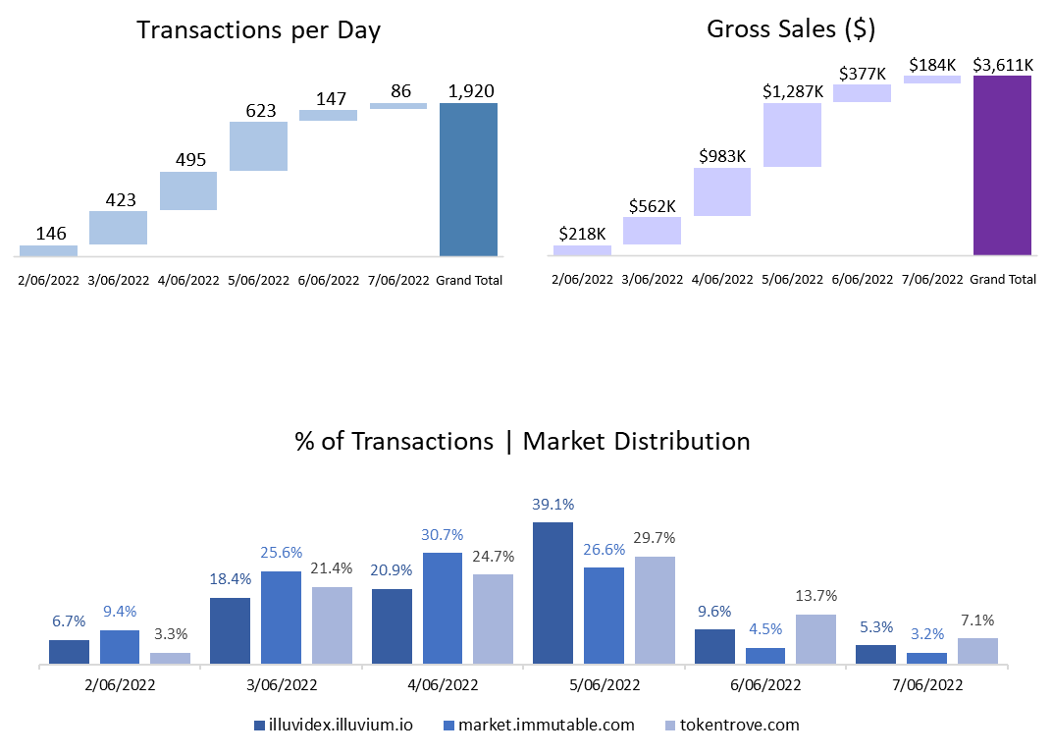
Illuvium Release
The Illuvium Release resulted in a total of 1.9K transactions, peaking at $1.2M in sales on 05/06.
Gross Sales generated by the this collection achieved 90% of total platform Sales for the week, more than 80% difference from the second place in transactions values, Gods Unchained, which contributed only 7.5%.
On most days, trades were made on Illuvidex market. Towards the end of the week, the traffic migrated to Tokentrove, which was the preference for 14% of customers on 06/06 and 7% on the last day of the analysed period

Slide 3
Traders
Illuvium contributed with 90% of all gross sales against 0.35% from Gods Unchained. On the other hand, the latter was responsible for the highest volume on the platform, reaching up to 97%.
The average sales/transaction for all the 4 NFT Collections presented was $25, where Illuvium Land achieved $1.7k, followed by Book Games with $370. Gods Unchained, the highest volume in transactions, came in last with an average transaction of $2.
Gods Unchained and Book Games players prefer TokenTrove as its marketplace, reaching 79% and 98% of total transactions, respectively
Besides the more aggressive decline on Illuvium sales, the average trending line presents an increase during the time in question.

